Slide 1
LOGIC GATES
UNIT 1

Slide 2
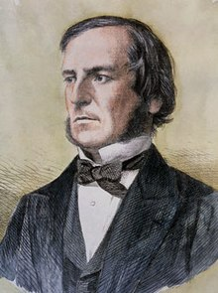
LOGIC GATES-INTRODUCTION
Logic gates are the basic building blocks of any digital system.
It is an electronic circuit having one or more than one input and only one output.
The relationship between the input and the output is based on a certain logic.
Based on this, logic gates are named as AND gate, OR gate, NOT gate etc.
The digital circuits use only two states as ON and OFF or HIGH and LOW or TRUE and FALSE
George Boole

Slide 3
Basic logic gates-AND,OR & NOT
AND Gate
An AND gate performs logical multiplication. An gate has two or more inputs and one output. If any input signal is LOW, the output signal goes LOW. The output is HIGH only when all the inputs are HIGH.

Slide 4
AND gate
With A and B as input logical variables the output Y is given by the expression.
Y = A.B = AB
For three input AND gate
Y = A.B.C = ABC
A truth table gives the output state for each possible input state combinations.

Slide 5
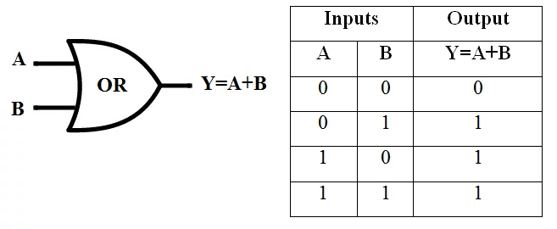
OR gate
An OR gate performs logical addition. An gate has two or more inputs and one output. If any input signal is HIGH, the output signal goes HIGH. The output is LOW only when all the inputs are LOW.

Slide 6
NOT or INVERTER gate
A NOT gate has only one input and one output. For the NOT gate, when the input is LOW (logic 0) the output is HIGH (logic 1) and when the input is HIGH the output is LOW. That is the output is the complement of the input.
Y = $\overline{A}$

Slide 7
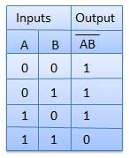
NAND gate
NAND gate
NAND can be imagined to be an AND gate followed by a NOT gate.
The output is 1 when any input goes to 0. The output is 0 only when all the inputs are in 1 state.
Y =$\overline{A.B}$

Slide 8
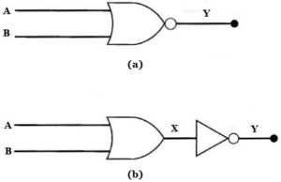
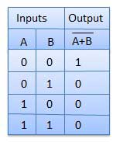
NOR gate
NOR gate
NOR can be imagined to be an OR gate followed by a NOT gate.
The output is 0 when any input goes to 1. The output is 1 only when all the inputs are in 0 state.
Y =$\overline{A+B}$

Slide 9
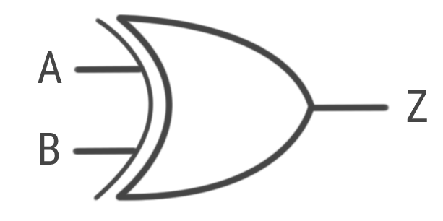
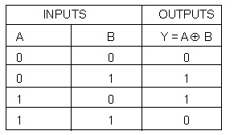
XOR or Exclusive OR gate
XOR or Ex-OR gate is a special type of gate. It can be used in the half adder, full adder and subtractor.
The exclusive-OR gate is abbreviated as EX-OR gate or sometime as X-OR gate
Y = $\overline{A}B+A\overline{B}$

Slide 10
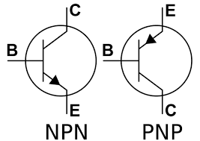
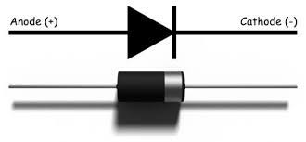
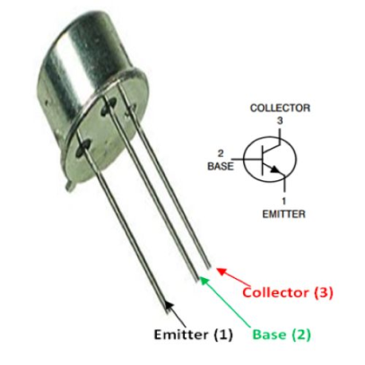
Diodes & Transistor

Slide 11
SEMICONDUCTORS
The addition of a small percentage of foreign atoms in the regular crystal lattice of silicon or germanium produces dramatic changes in their electrical properties, producing n-type
and p-type semiconductors.

Slide 12
N & P-type semiconductors
Pentavalent impurities
Impurity atoms with 5 valence electrons produce n-type semiconductors by contributing extra electrons.
Trivalent impurities
Impurity atoms with 3 valence electrons produce p-type semiconductors by producing a "hole" or electron deficiency.

Slide 13
Forward Bias & Reverse Bias

Slide 14
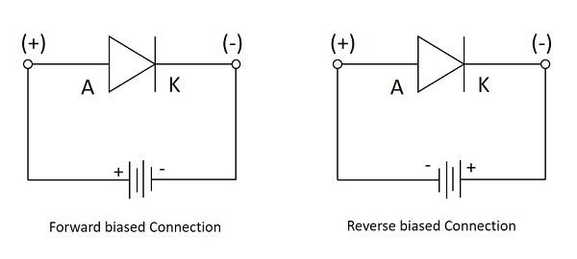

Slide 15
V-I Characteristics

Slide 16
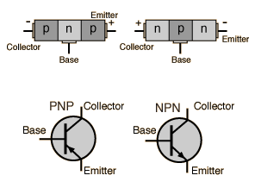
transistors

Slide 17
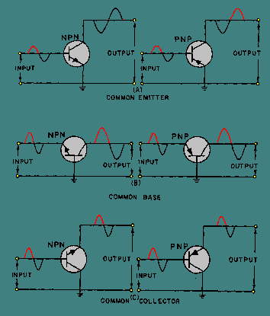
Configuration

Slide 18
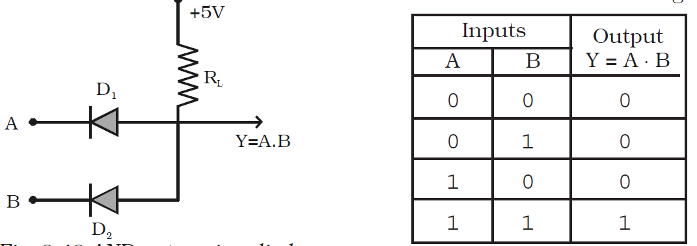
AND GATE using diodes

Slide 19
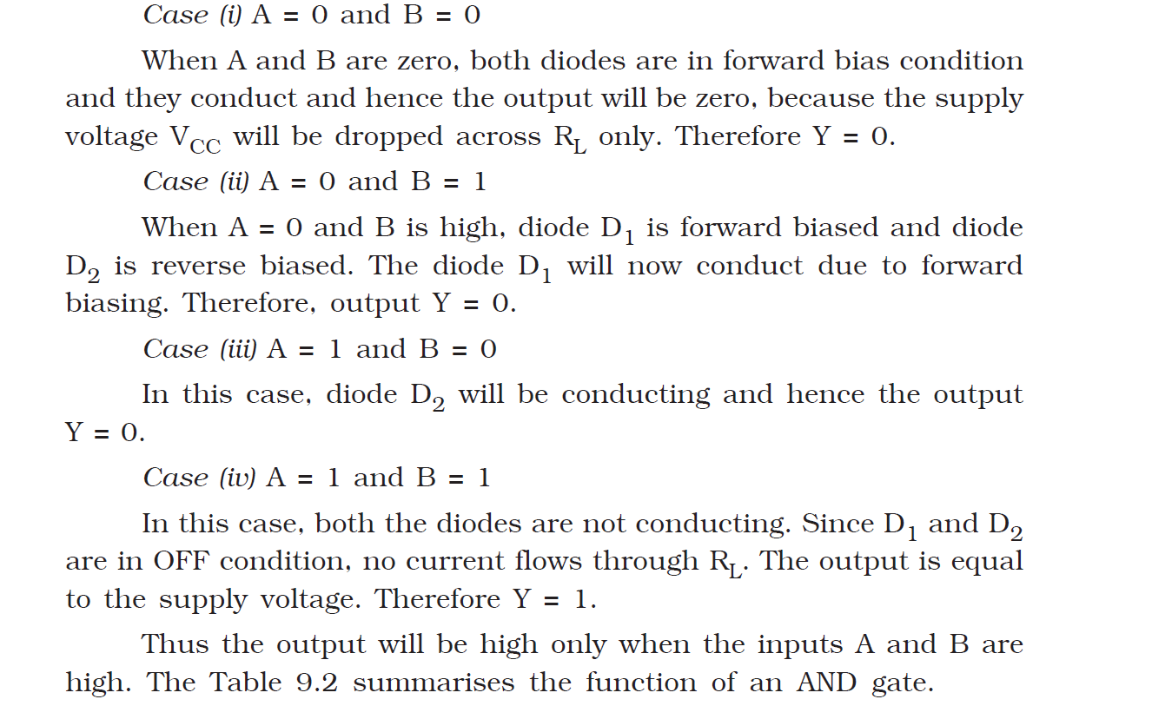

Slide 20
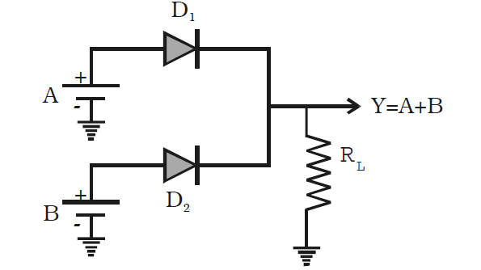
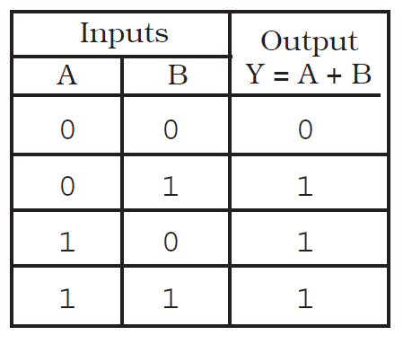
OR GATE using diodes

Slide 21
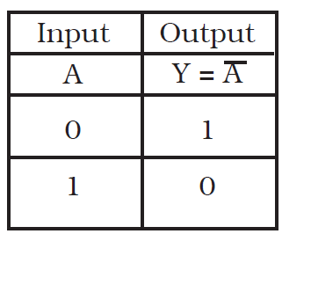
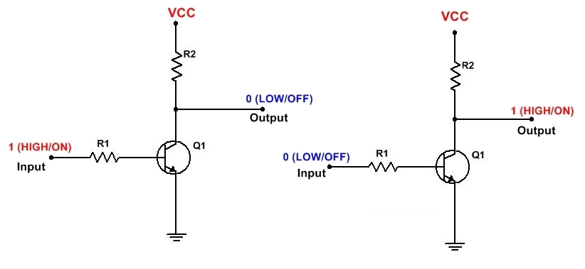
NOT gate using transistor

Slide 22
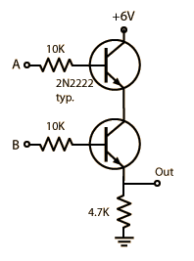
AND gate using transistors

Slide 23
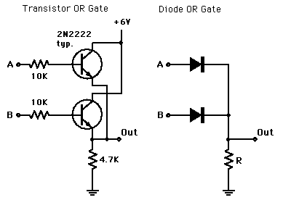
OR gate using transistors

Slide 24
NAND & NORGATE
The NAND and NOR gates are the complements of the previous AND and OR functions respectively and are individually a complete set of logic as they can be used to implement any other Boolean function or gate.
But as we can construct other logic switching functions using just these gates on their own, they are both called a minimal set of gates.
Thus the NAND and the NOR gates are commonly referred to as Universal Logic Gates.

Slide 25
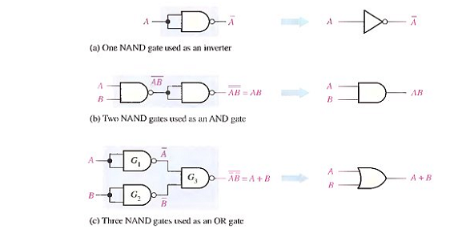
NAND GATE

Slide 26
NOR GATE

